Slide 1
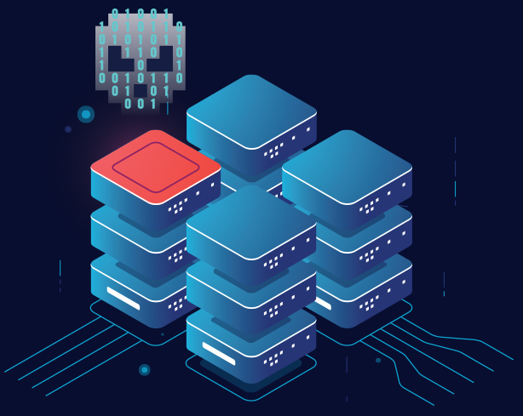

OWASP Top Ten
#10 - Server-Side Request Forgery (SSRF)
Image Source

Slide 2
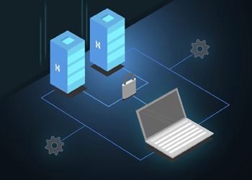
SSRF - Server-Side Request Forgery
A web security vulnerability that allows an attacker to induce the server-side application to make requests to an unintended location.
SSRF attacks consist of an attacker tricking the server into making an unauthorized request.
Source Image
Notes:
Server-side request forgery (SSRF) is a type of attack that allows an adversary to make arbitrary outbound requests from a server.
An attacker can use SSRF to pivot throughout corporate networks, exploit otherwise unreachable internal systems, or query metadata endpoints to extract secrets.
Just by making a malicious HTTP request to the server, the attacker can instruct the backend to perform malicious actions.

Slide 3
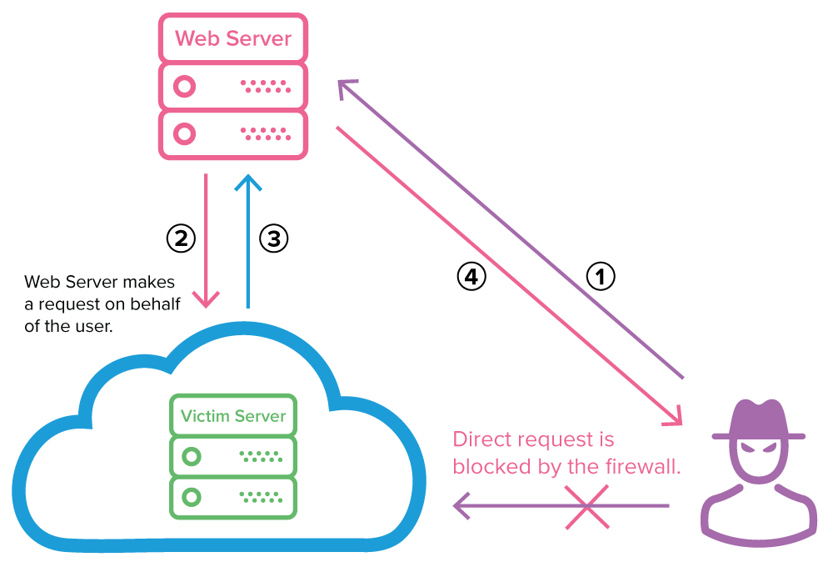
Typical exploitation of a server-side request forgery vulnerability
Image Source
Notes:
The attacker sends a forged request to a web server that is vulnerable to SSRF and resides on the same internal network as the target server.
The vulnerable web server sends the attacker-controlled request to the victim’s server, bypassing the firewall.
The victim’s server responds to the web server with the requested data.
If the specific SSRF vulnerability permits it, the data is sent back to the attacker. In most cases, the attacker will need to exfiltrate or infer this information by other means (out-of-band).

Slide 4
Basic or non-blind SSRF
A malicious request made by the attacker results in visible data being returned by the server.
Such attacks are excellent for threat actors looking to exfiltrate data from secret files and assets or to check if specific system ports are open and running services.
Attacker can modify request to specify a URL local to the server itself. For example:
POST /product/stock HTTP/1.0
Content-Type: application/x-www-form-urlencoded
Content-Length: 118
stockApi=http://localhost/admin
*Here, the server will fetch the contents of the /admin URL instead of the product page and return it to the user.
Notes:
A publicly accessible (web) server can be tricked by the end user into providing access to sensitive files on that server or access to other, more privileged systems or operations that are otherwise restricted for the end user.

Slide 5
Blind SSRF
Performs unauthorized actions on the server’s backend.
For example:
Modifying something on the server
Altering or deleting files
Changing permissions
Example:
Attacker changed URL to:
weatherApi=http://external-server/a-very-large-image-file.png
*Here, the local server may repeatedly attempt to fetch this abnormally large file from the external server, eventually causing the web application to crash, resulting in a denial of service (DoS).
Notes:
This attack is “blind” as the focus isn’t on retrieving a visible response or data but rather performing a detrimental action on the server’s behalf;
Performing a variety of unauthorized operations rather than going for data exfiltration.

Slide 6
DEMO
A new startup has decided to create a new social media, the next Facebook.
This new social network has the ability to add profile pictures to the person’s profile.
Instead of just allowing the upload of profile pictures, it would be awesome to use any image on the internet by just providing a URL.
When a user sends a request with image URL, the server will request the provided image URL, return the image back to the user, and then update the profile image.
Let's take a closer look at what might be possible by exploiting this SSRF vulnerability.
Notes:
https://learn.snyk.io/lessons/ssrf-server-side-request-forgery/javascript/#step-6yx8QIAn39D0hRucmBa68h

Slide 7
Impacts of an SSRF attack:
Appear to originate from the organization hosting the vulnerable application, causing potential legal liabilities and reputational damage.
Unauthorized access to sensitive configurations—including server files, cloud provider metadata, and open ports.
Internal port scanning—letting an attacker Identify and exploit unsecured services.
Exploit chaining—exploits can be “chained” into other attacks that are more damaging, ranging from reflected XSS to remote code execution.

Slide 8
Mitigations
Restrict Protocols
Allowlist / Whitelist
Zero-Trust Mindset
Principle of Least Privilege
Enable Logging
Website Application Firewall (WAF)
Intrusion Detection/Prevention Software (IDS/IPS)
Notes:
Your internal applications or servers should never blindly trust the input or assume that it’s coming from an authentic source.
Restrict Protocols - such as allowing only HTTP and HTTPS requests, depending on the needs of the application.
Allowlist - allows access to only the permitted objects or in this context, locations, making the process more selective and secure.
Zero-Trust Mindset - sanitize input and minimize the possibility of input being influenced by the end user.
Principle of Least Privilege - the system only grants access to applications, systems, and users that are absolutely necessary via an allowlist.
Enable logging - of any changes on the server and track file change dates. That will help you detect any malicious code, infected files, and unauthorized access to your server.
Website Application Firewall (WAF) - will help you prevent common automated attacks and may save you from more sophisticated attacks. *Do not operate a web server without employing a firewall.
Intrusion Detection/Prevention Software (IDS/IPS) – won’t necessarily save you from an SSRF attack attempt. However, it will alert you that something’s amiss much sooner than if you aren’t using it.

Slide 9
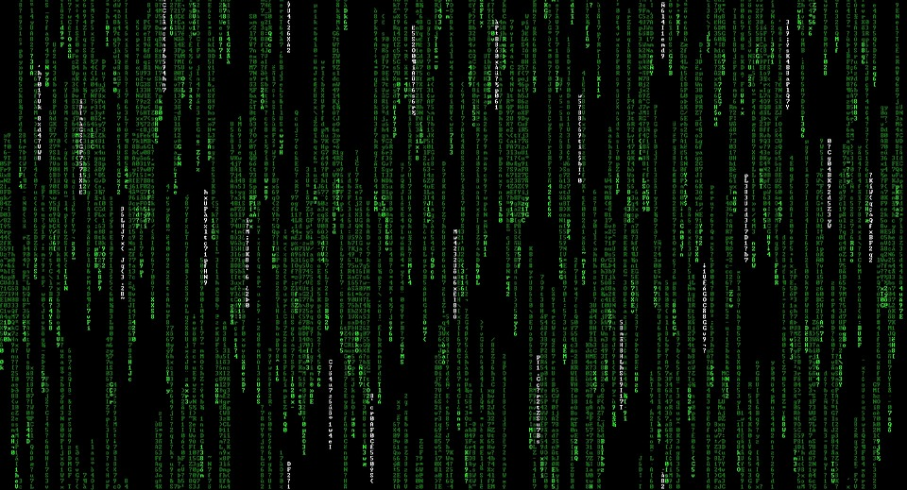
Case Study: CapitalOne
In 2019, CapitalOne fell victim to an SSRF attack. Led to leaking over 100 million customer records.
The site was hosted on Amazon’s AWS platform in which an SSRF vulnerability was present.
The web application firewall (WAF) failed to identify and block the attack.
The access credentials were too permissive.
Combined these are perfect conditions for a successful SSRF attack.
Source
Source
Source
Source
Notes:
The vulnerability allowed the attacker to obtain AWS credentials by using the application server itself, as AWS enables the application to obtain its own metadata. Once the attacker had secured the credentials, they could funnel the stolen data using AWS management tools, such as the command-line interface (CLI) and E3 storage.
It remains one of the most well-known successful SSRF attacks today. The attack was successful because of a mix of poor security practices and the presence of bugs within its infrastructure.

